Slide 1
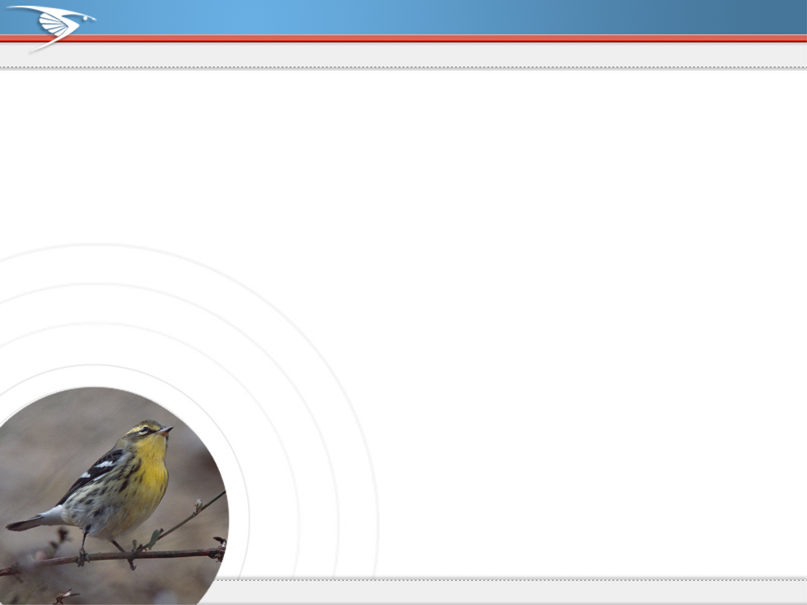

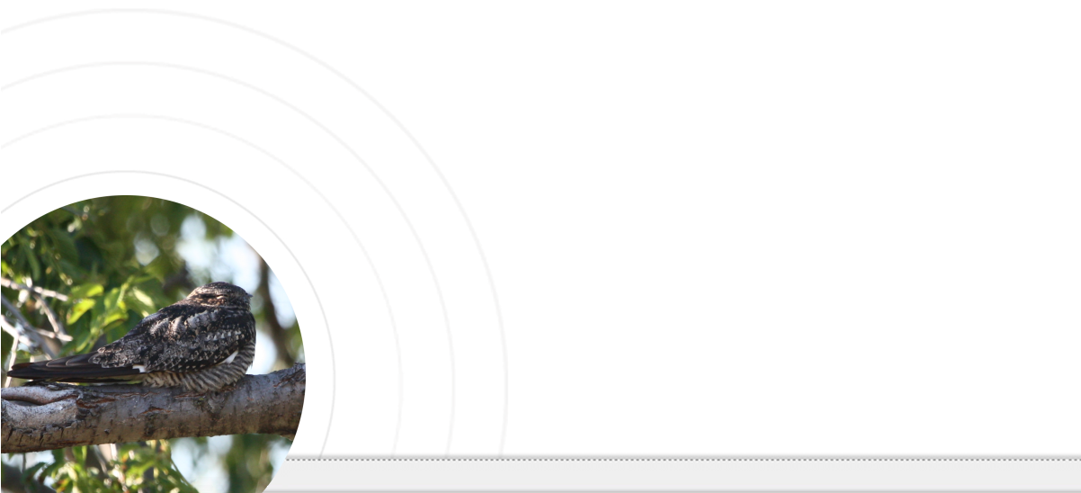

An Introduction to
By Paul J. Hurtado
Notes:
These slides are modified from the eBird Promotional Materials provided at http://ebird.org/content/ebird/about/ebird-promotional-material

Slide 2
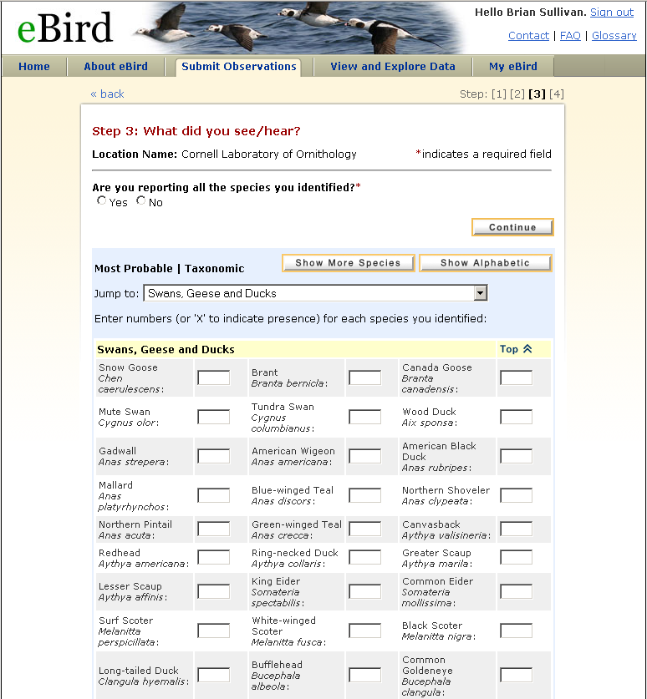
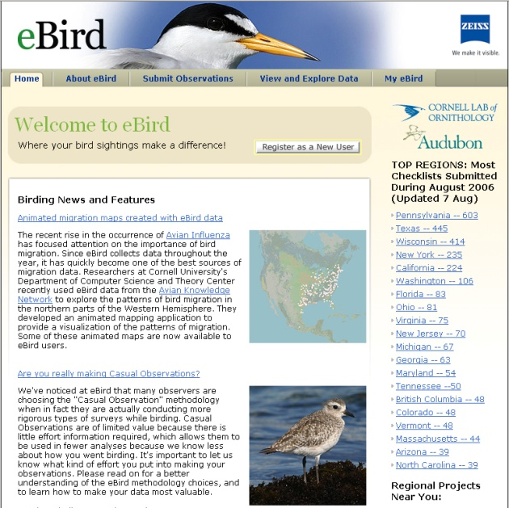
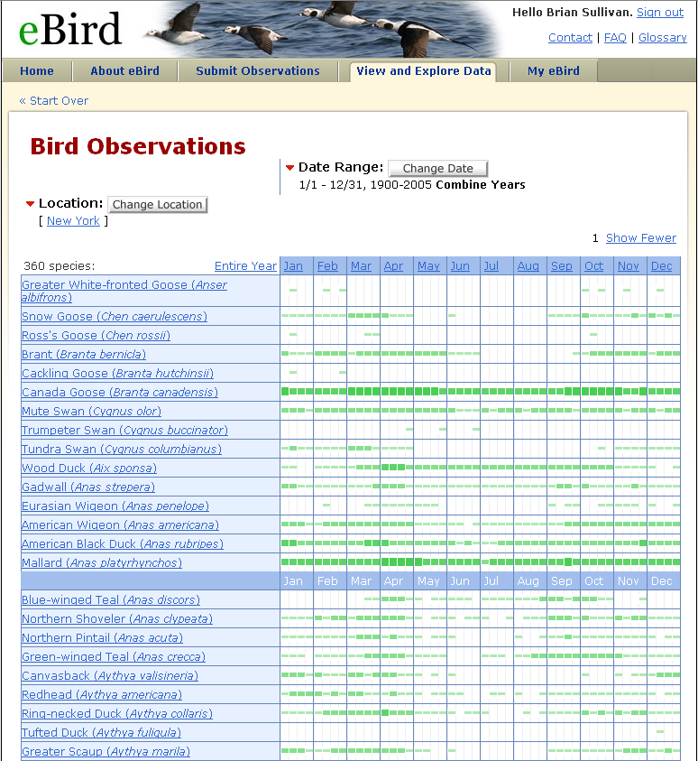



Where Birding Meets Science
Notes:
eBird is a joint project of the Cornell Lab of Ornithology and Audubon with support from the National Science Foundation.

Slide 3
Where Birding
Meets Science
Talk Overview
  What is eBird?
  Navigating the eBird website:
    Exploring the data
    Contributing and organizing
    your own observations
  Additional resources
  Q&A

Slide 4
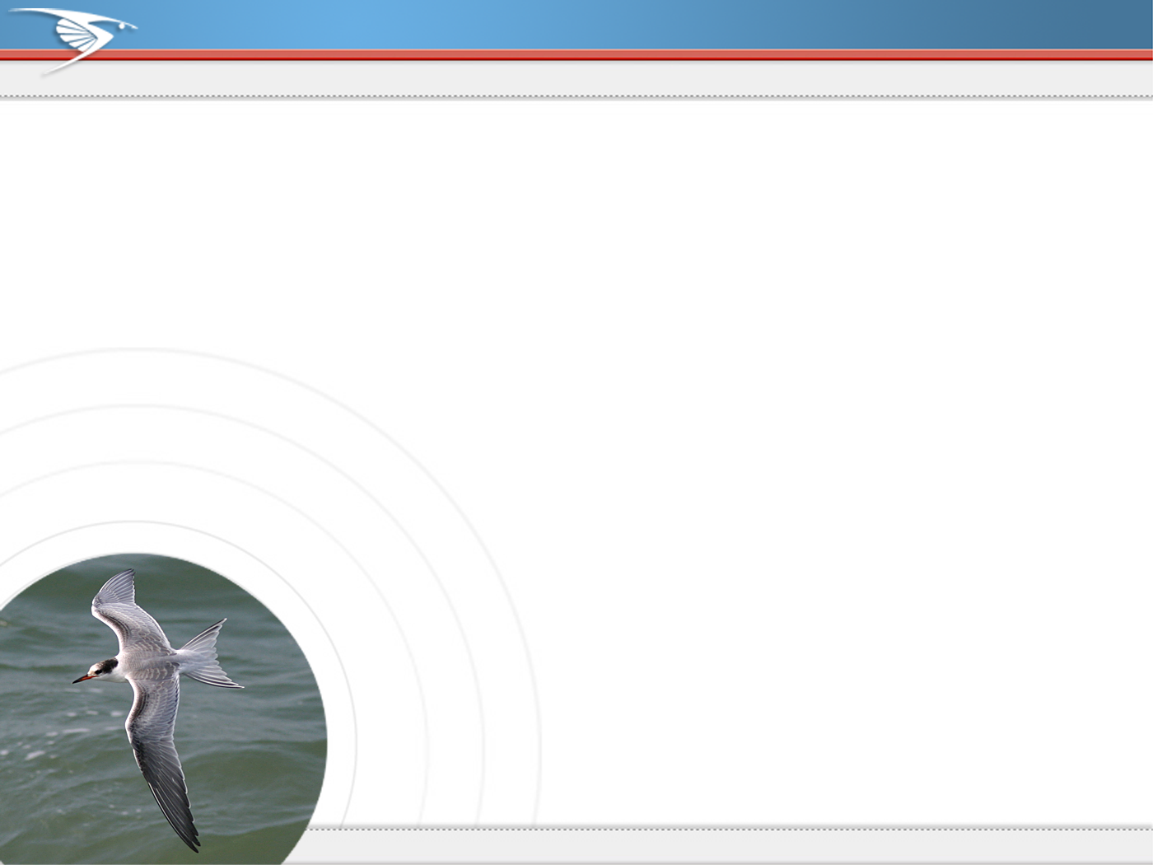
Impacts of Citizen-Science
Christmas Bird Count
Since 1900
From 25 to 2000 count circles over 100 years
Currently 50,000 participants
Breeding Bird Survey
Since 1966
From 600 to 3700 routes over 40 years
Several thousand participants
Notes:
“Citizen-Science” projects like the Christmas Birds Count (CBC) and the Breeding Bird Survey (BBS) have been collecting bird data for decades. Both studies have proven invaluable in estimating population trends in birds over time at very large scales.

Slide 5
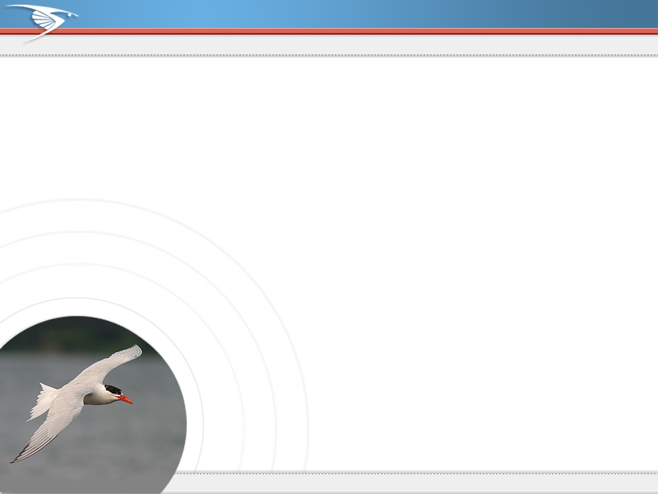
What is eBird?
Gather
Internet-based checklist program
Tool for gathering observational data
Tool for maintaining personal records
Archive
Persistent archive of bird observations
Gathers baseline data on bird distribution and abundance
Disseminate
Public tool for data visualization
AKN, conduit for observational data
Notes:
eBird does three very important things: It gathers data from birders via an online tool that allows individuals to keep their personal records online; it archives these records in perpetuity, backing them up for the long term in multiple places, and also gives the user the ability to consolidate and download their own data to be backed up at home; and most importantly it makes these observations available to science. With a large user base, eBird is contributing over 1.5 million observations per month to the birding and scientific communities.

Slide 6
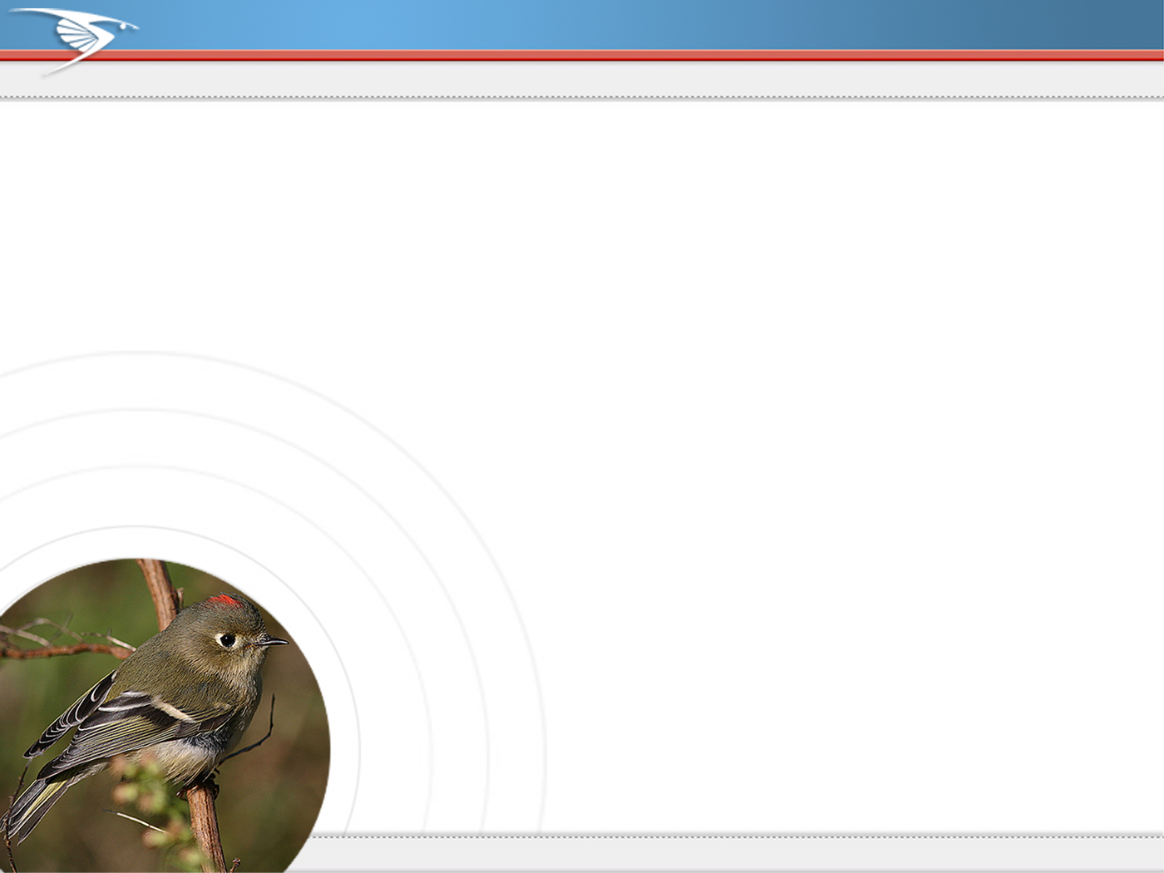
How is eBird Different?
Worldwide monitoring program
All species & field identifiable forms
Year-round!
Advanced geo-referencing
Broad user-base
Notes:
eBird is different from other citizen-science projects (e.g., BBS and CBC) in its broad spatial scope, its year-round time component and its focus on all species of birds. It also appeals to a broad diversity of birders and has advanced mapping capabilities that allow scientists to do more with the data.

Slide 7
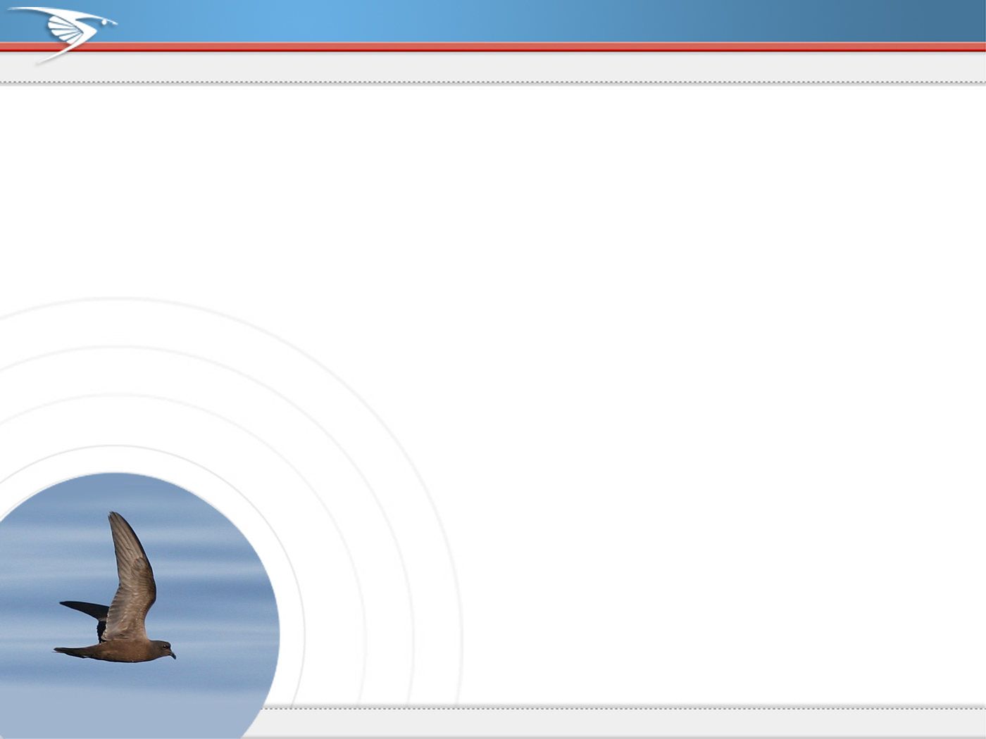
eBird — 2011 Stats
~70,000 account holders and growing
~300,000 site visitors
230 countries/territories
>5,000,000 checklists submitted
9,152 species reported
~70 million observations reported
Notes:
The vast majority of eBird “Users” simply look at the data output eBird provides to the birding community. A much smaller proportion actually enter data into the system. We are hoping to change that by encouraging you to submit your own observations into eBird, to share them with the birding community and the world.

Slide 8
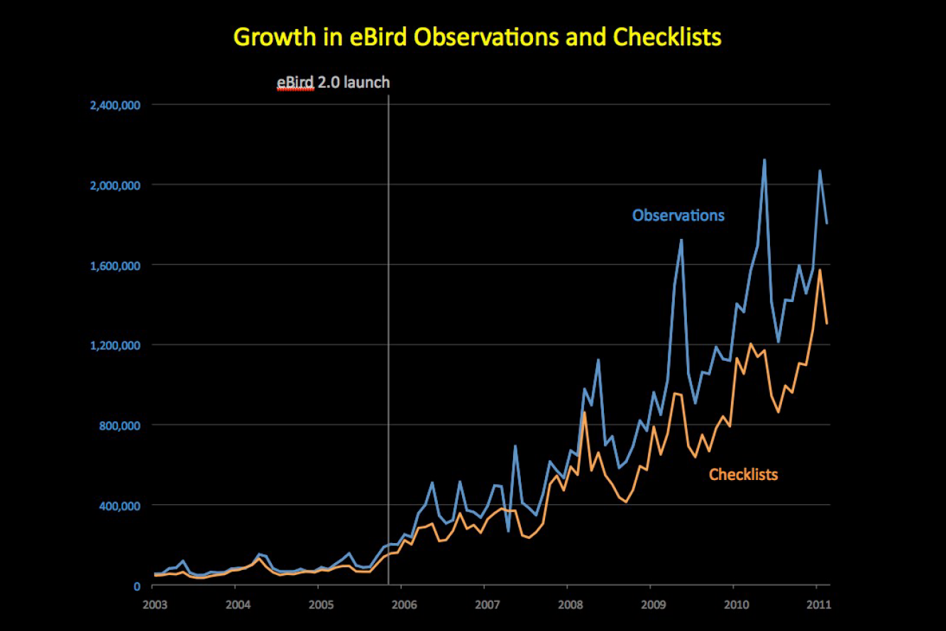
Notes:
From http://ebird.org/content/wi/news/the-state-of-ebird-2010

Slide 9
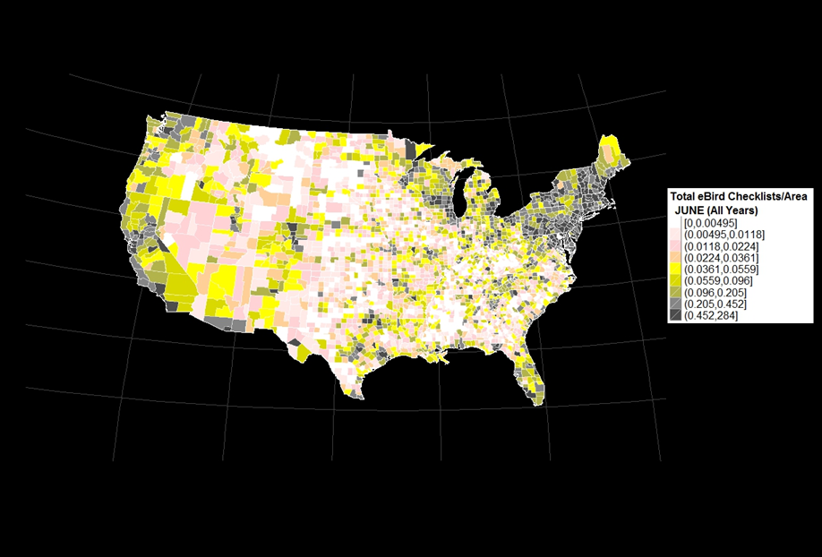
Notes:
eBird has the greatest coverage where population densities are highest: people bird close to home! Where are eBird data lacking? Low population density areas & “off season” times of year (see previous slide for seasonal peaks and troughs). SOURCE: https://picasaweb.google.com/110463962218302154116/EBirdCountyChecklistTotalsPerCountyAreaJuneAllYears

Slide 10
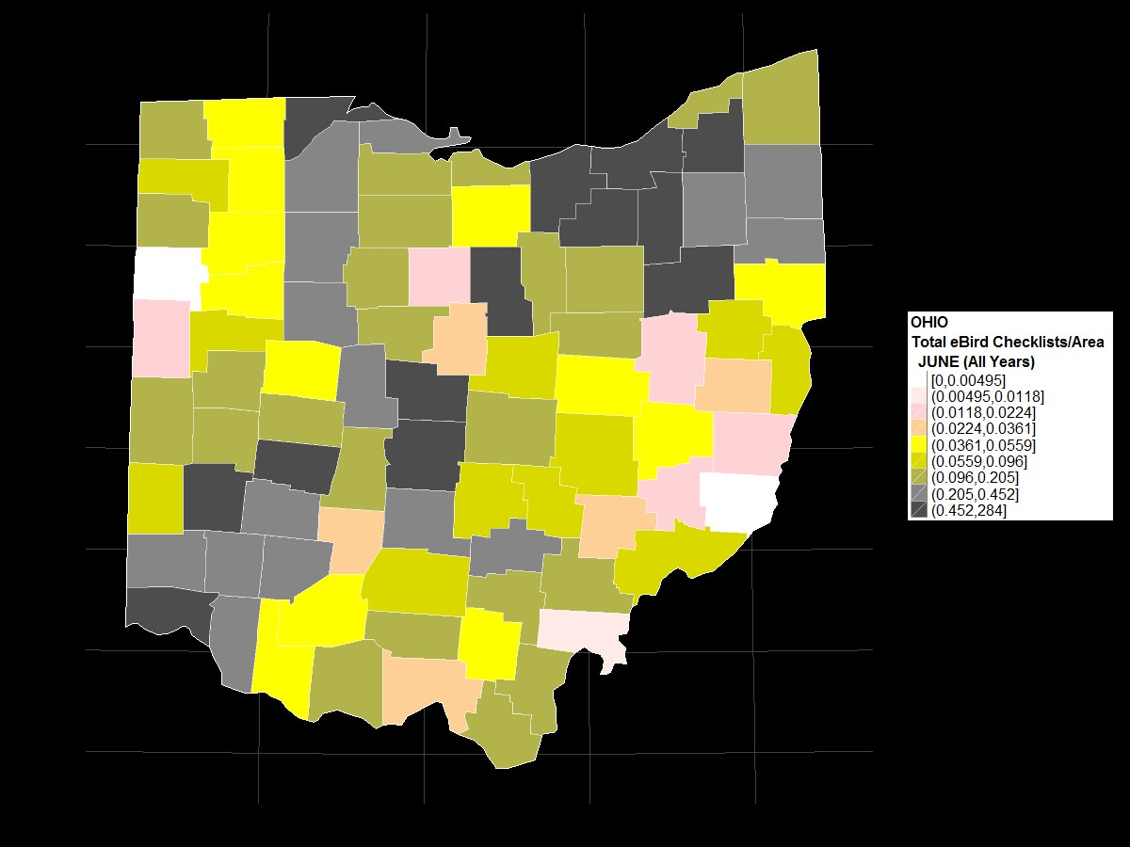
Notes:
SOURCE: https://picasaweb.google.com/110463962218302154116/EBirdCountyChecklistTotalsPerCountyAreaJuneAllYears

Slide 11
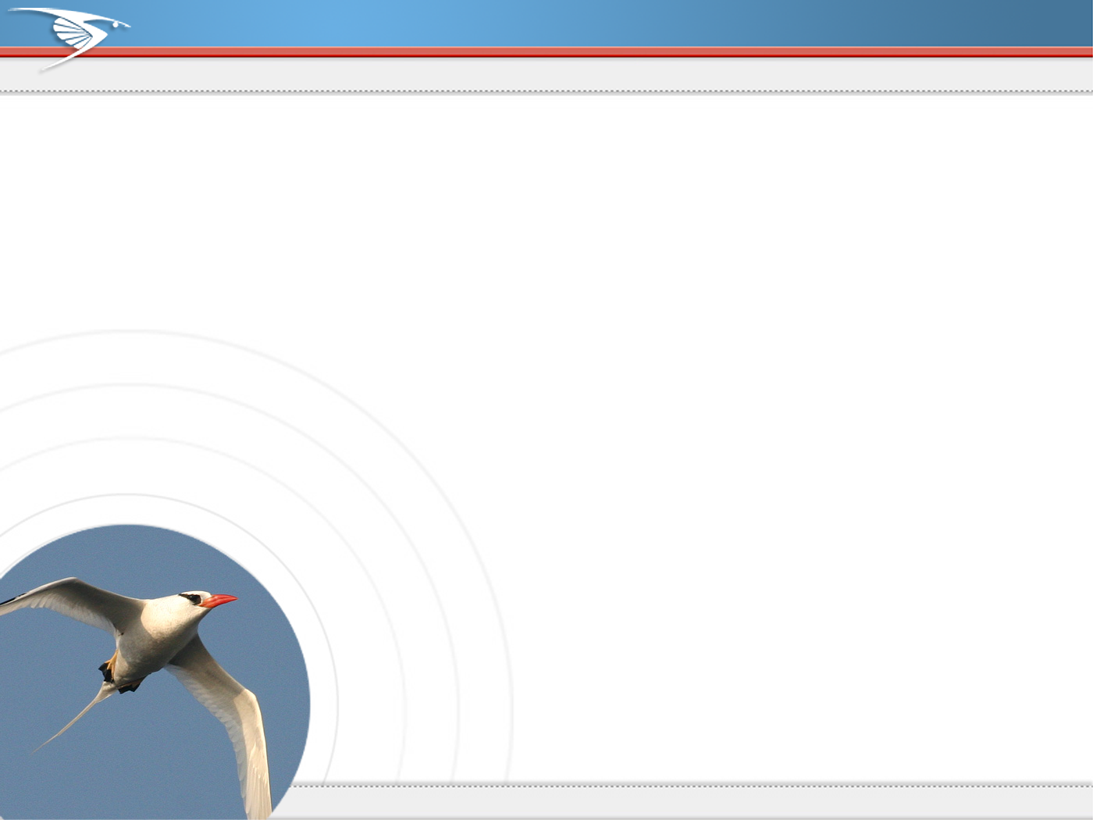
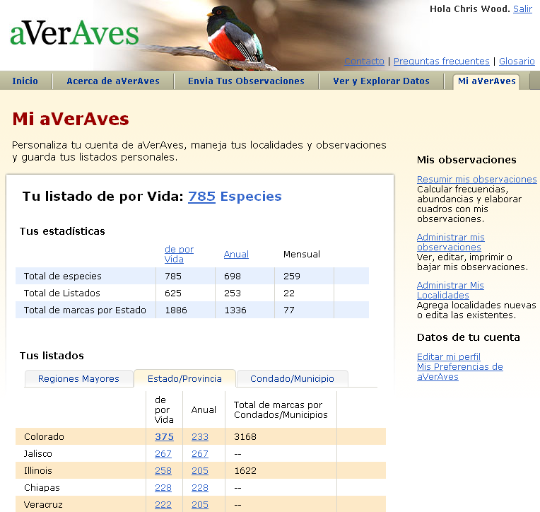
Encouraging Participation - Integration
Applied
(BCN)
eBird
National
(aVerAves)
Local
(Vermont)
Notes:
eBird has a variety of “Portals” that are often specific to the interests of a region or project. All eBird portals integrate seemlessly on the back-end, so birders can you any or all of the portals and still have their data appear in one place. For example, a California birder might want to use California eBIrd as their home eBIrd portal because the content there will be customized to the interests of California birders. Others might want a broader birding perspective and opt for the main eBird portal at www.ebird.org. Either way, users can enter data for any location from any portal. The same scenario holds true for counties in South and Central America that have their own portals (e.g., eBird Chile).

Slide 12
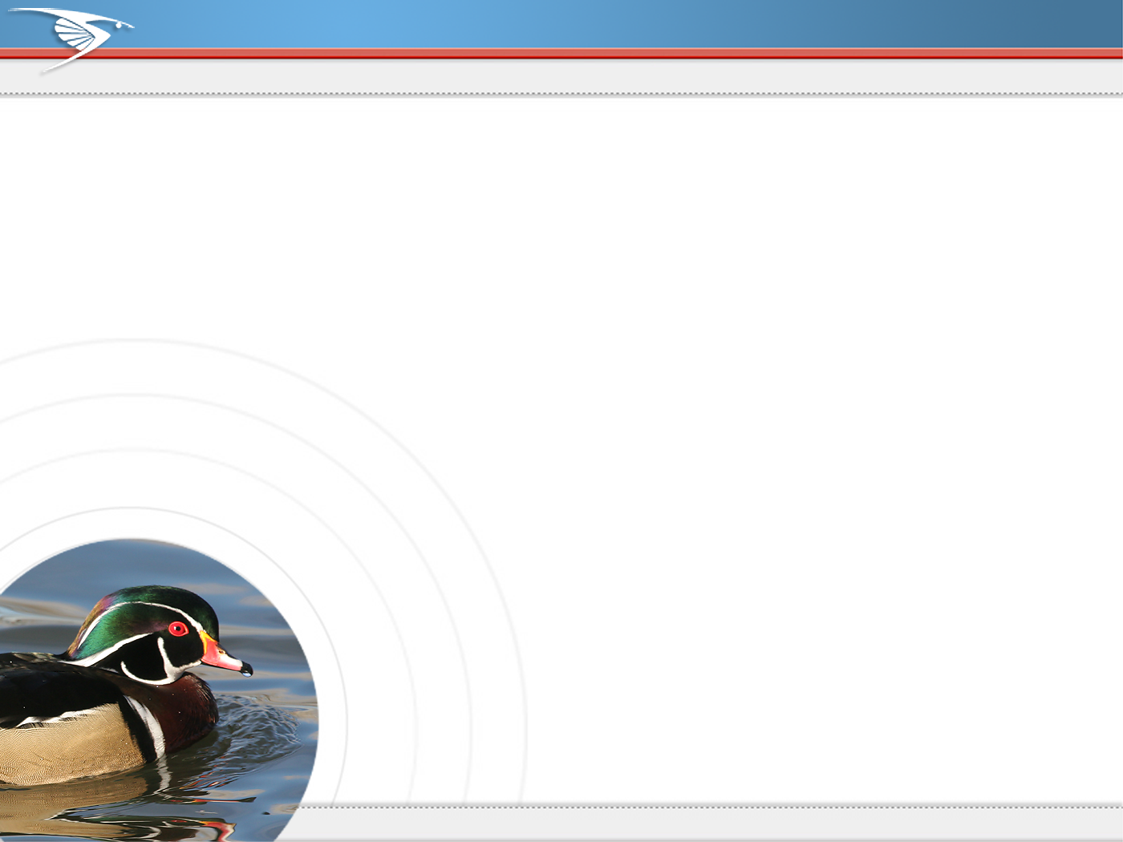





Regional Applications – Empowering Local Birders
Notes:
A few example of eBird portals

Slide 13
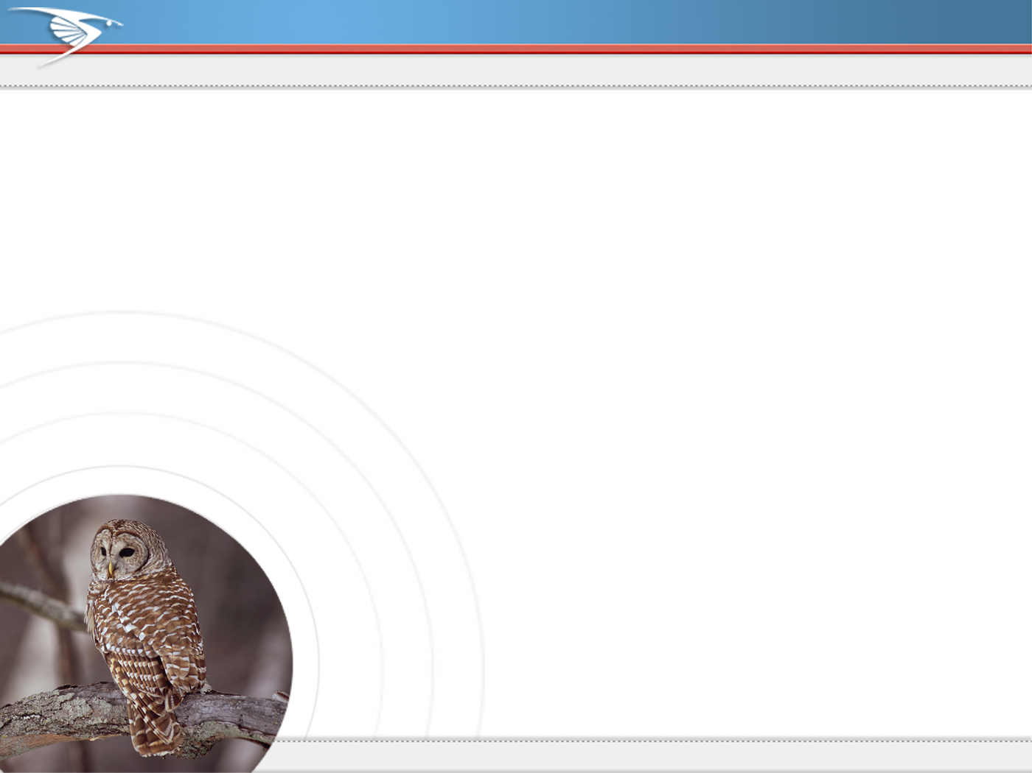
What Happens to the Data?
eBird data go global
Combine with other datasets
AKN
eBird
Bird
Studies
Canada
R.M.B.O
PRBO
Conservation
Science
Available for download
Analysis tools
Visualization and exploration
Notes:
When you enter your data into eBird it becomes part of a bigger network of biological data being collected worldwide. All eBird data join the Avian Knowledge Network (www.avianknowledge.net) where they are combined with a host of other bird data from scientific projects, government agencies etc. These data are then combined with both biological data and a host of other datasets (e.g., climate data) from around the world to provide a data resource for science and conservation. By entering your data into eBird you are improving the scientific understanding of birds, and contributing to the conservation of birds and biodiversity.

Slide 14
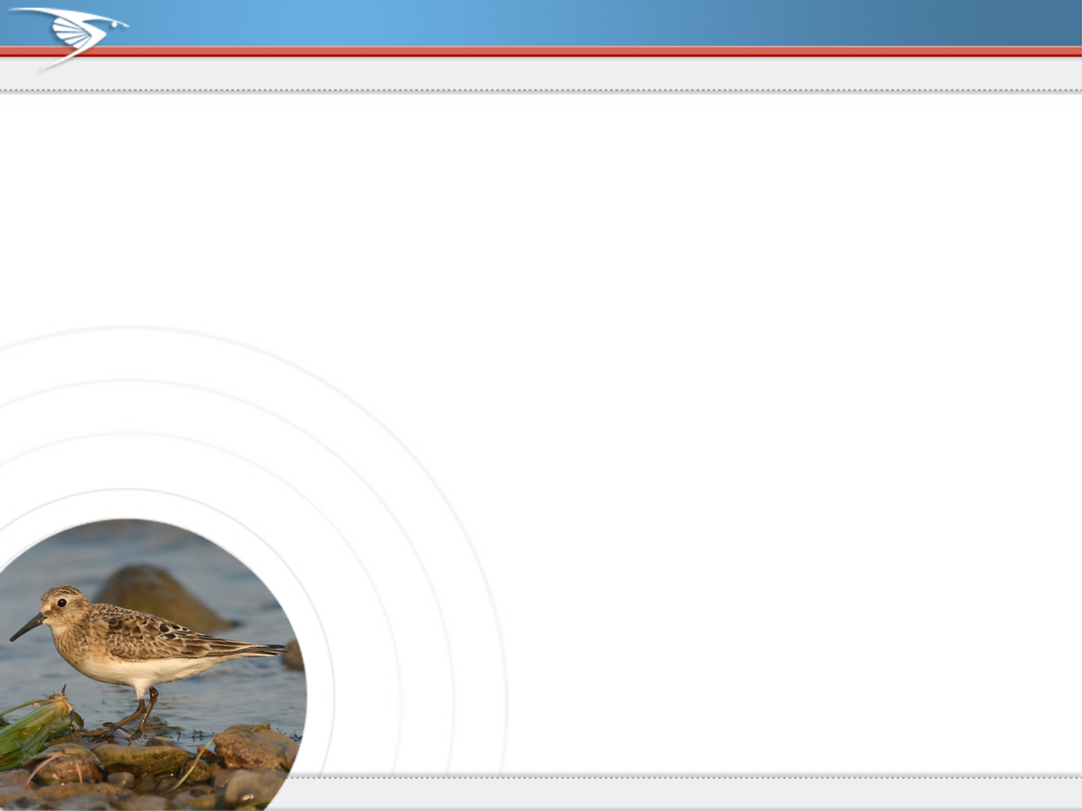
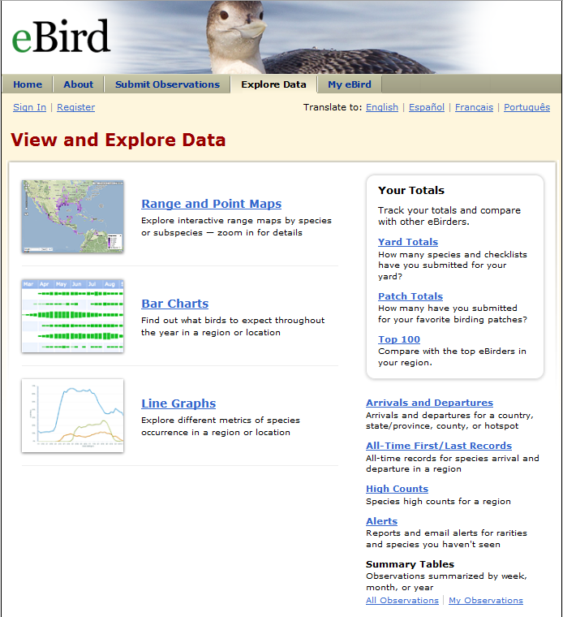
eBird Data Visualization & Summaries
Notes:
In addition to the My eBird tab, which lets you explore your own personal birding history, eBird has a series of output tools designed to provide useful information to birders. Some of the tools here include species maps, bar charts showing bird frequency for states, counties, and specific locations, tables of species arrivals and departures by location, record early and late dates, high counts, and the top100 birders in a region.

Slide 15
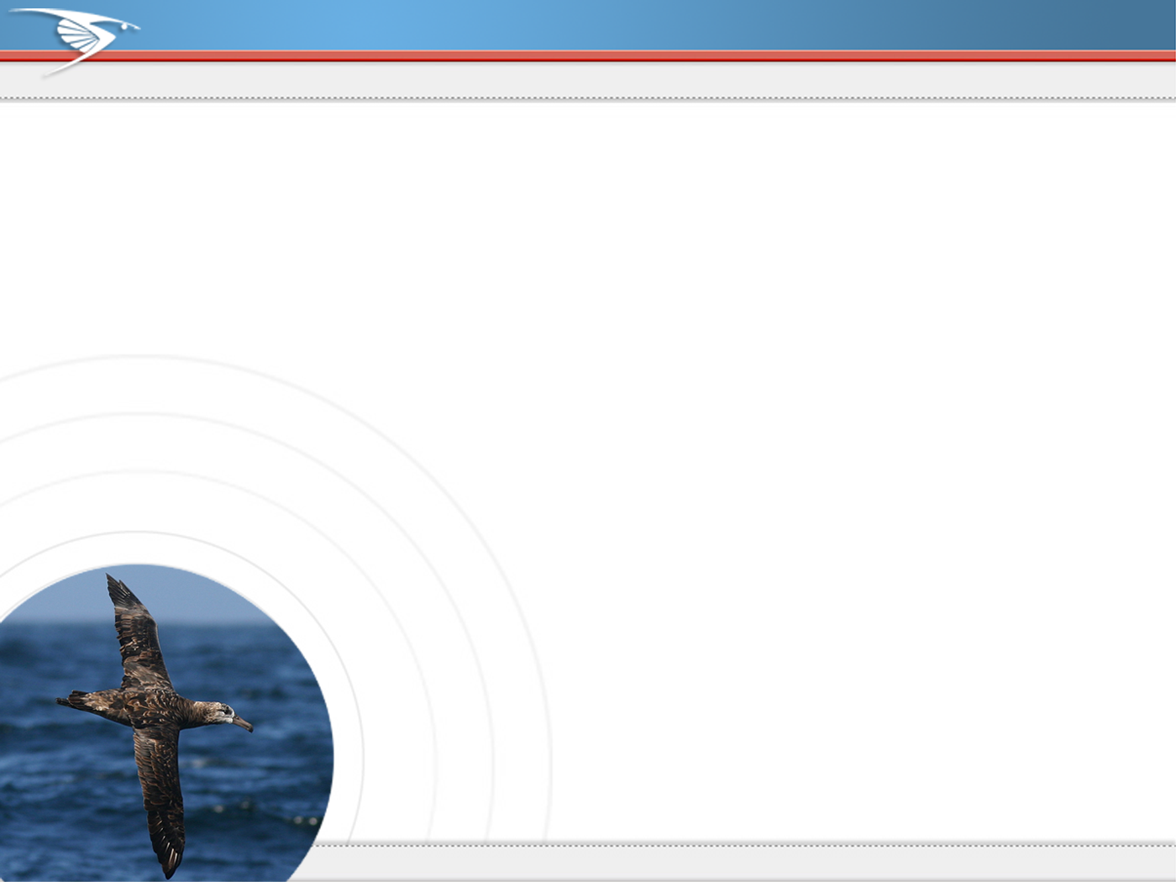
eBird—Data Quality
Every record submitted to eBird goes through
some level of data verification
Rarities
Aseasonal reports
Unusually high counts
Network of 500+ reviewers
Goal: one per county
Help them: leave comments!
Notes:
When you click ‘Confirm’, the record goes into a queue where it is reviewed by a regional editor. You may be contacted to provide further details in the case of extreme rarity. You can read more about the eBird data quality process here: http://ebird.org/content/ebird/about/ebird-data-quality

Slide 16
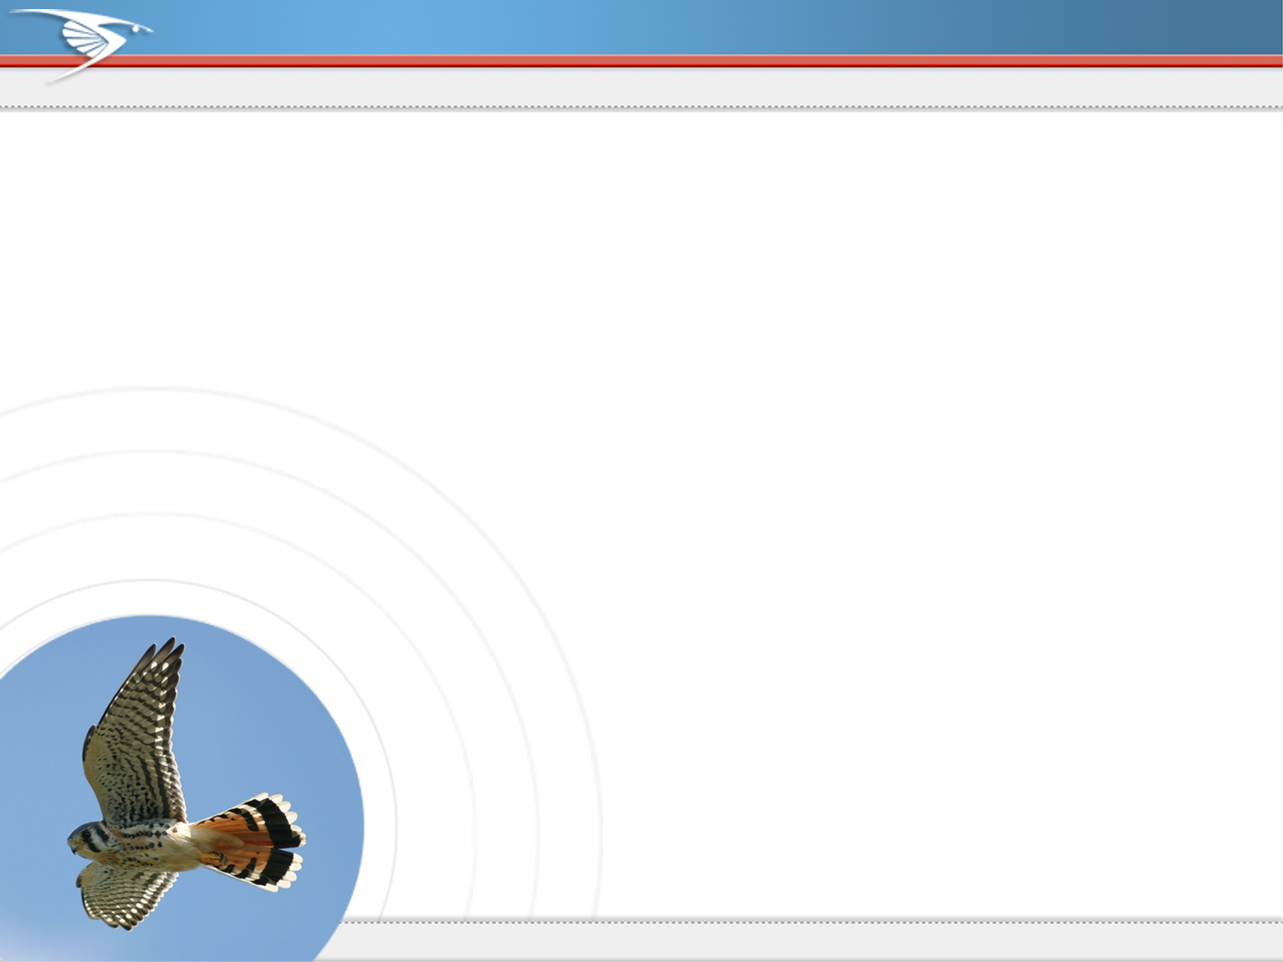
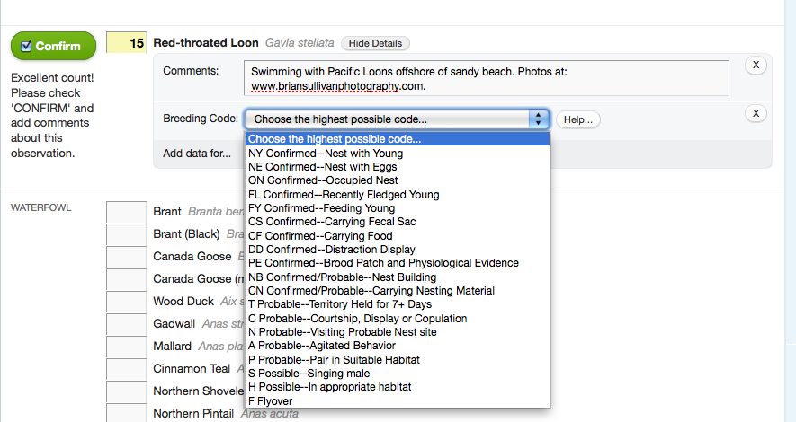
eBird—Data Entry—Age, Sex, Species Comments
Notes:
Each species reported has an open text ‘comments’ box used for supporting documentation and notes. You can also add details of age/sex, and add breeding information for each species on your checklist. General checklist comments such as weather information or bird companions can be added in the next step.

Slide 17
What about me?!
So… why contribute? What’s in it for me?
Make your observations count!
eBird keeps helps you organize
your observations, lists.
It makes me a better birder.
Makes birding even more
accessible, social, & fun!
Notes:
eBird is different from other citizen-science projects (e.g., BBS and CBC) in its broad spatial scope, its year-round time component and its focus on all species of birds. It also appeals to a broad diversity of birders and has advanced mapping capabilities that allow scientists to do more with the data.

Slide 18
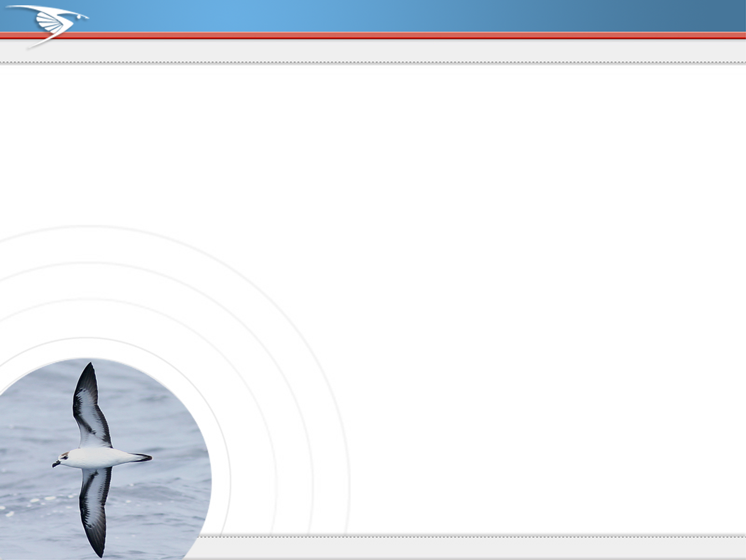
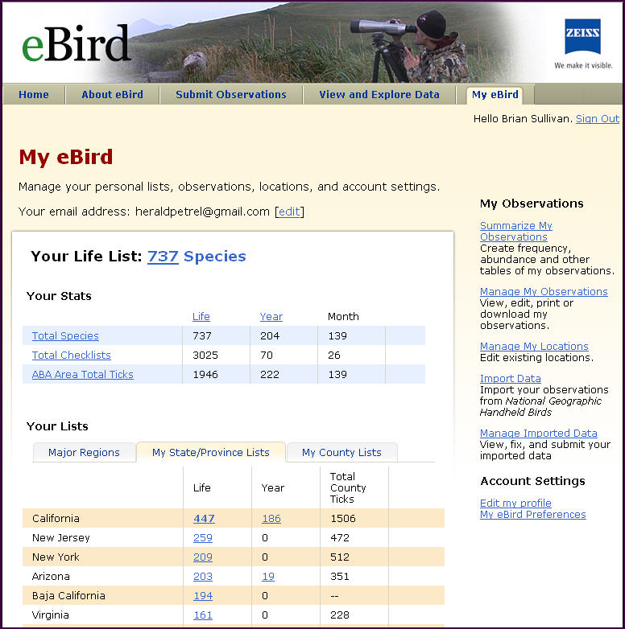
Keep Track of Your Lists Using My eBird
Maintain and manage lists
Regional, state and county
View your eBird stats
Manage your data
View and manage profile
Notes:
The most important part of sustaining interest and participation in eBird is the user reward people get through the My eBird tab. This is where you’ll find all your stats, bird lists, and personal management tools. The My eBird page is designed to provide users with a complete birding history, and compile lists and stats for all the locations you’ve visited and collected bird data.

Slide 19
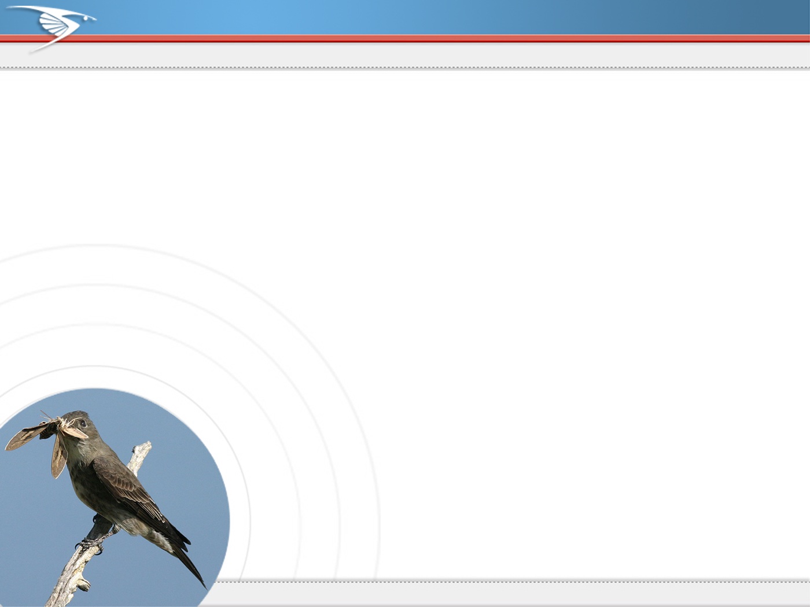
www.ebird.org
Notes:
Please log on to eBird today and become part of ornithological history!

Slide 20
Notes for navigating the eBird website
The ebird website is organized into 5 sections:
3 of 5 sections can be used by anyone (no account/sign-in
is required to browse the data)
  Home: News feed and a few resources on the sidebar.
  About: The links listed on the right are a goldmine
  of eBird “HowTo” information!
  Explore Data: Data visualization tools
    Maps & Barcharts are most useful
    Also see the “Listing” links (in the box) and the arrival/departure links.
    Maps: single species; easy to specify regions, timeframes
    Barcharts: Visualize all (species) observations by region, timeframe
      “Download histogram data” link allows user to open data as a
      spreadsheet; Great for doing even more with eBird data!
    For beginners/students: Use Maps, Barcharts with AllAboutBirds.org
2 of 5 are for contributing users (requires login)
  Submit Observations:
  My eBird: manage observations, view lists.
  (see next slide for details)
Notes:
Notes for navigating the website

Slide 21
Notes for navigating the eBird website
(… continued)
2 of 5 are for contributing users (requires login)
  Submit Observations: Where birders enter sightings
    Mandatory data: location, date, time of day
    Two types of data collected: Effort & Observations
    Effort = Stationary count? Traveling/walking?
    How far? Time duration? # Observers?
    * Helps eBird give you a list of expected species for submitting…
    Observations: Species? Number or presence (“X”)?
    Optional: Comments/notes, age, sex, breeding status
  My eBird: manage observations, view lists, etc.
For more on entering (valuable) checklists? → About
  eBird Tutorial (includes registering, entering checklists)
  Making checklists more valuable
  Improving your eBird reporting skills
  Embedding photos, video in checklists
  Breeding Codes, etc.
Notes:
Notes for navigating the website

Slide 22
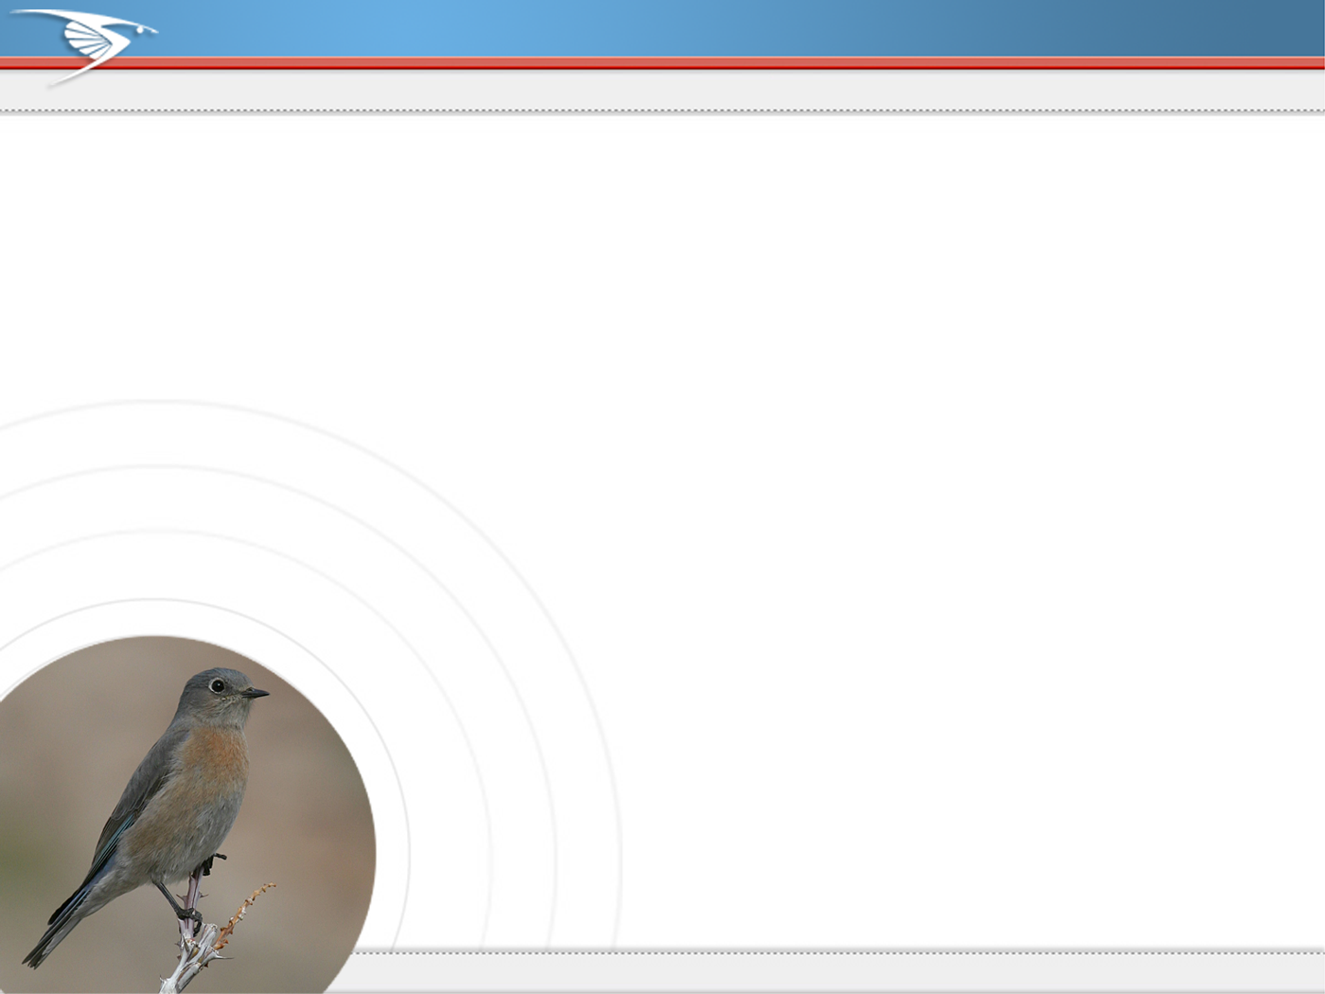
How to make your observations more meaningful
Your bird observations can be more valuable to science if collected in a particular way
Be precise when recording your location
Tell us what kind of birding you did
Estimate numbers for all the birds you see
Submit complete checklists each time you go birding
Seek out under-birded areas
Do a standardized count once a week
Document your rarities
Notes:
Birders are gathering massive amounts of information about birds every day. But think about the various ways people record what they see. Some write notes in field notebooks, others enter observations into home databases, others still don’t take notes at all. To remedy this and to provide a tool for birders to record what they see, we created eBird. But simply creating the tool isn’t quite enough to make sense of the myriad ways in which birders record their observations. To add another level of value to your data, you can take several simple steps that allow us to make better use of the birds you report, and to use these observations in the highest level of data analysis. Those basic steps are as follows:
Be specific about where you were birding, and plot the location accurately on the map
Make sure to include effort information on all your checklists, that is, tell us what kind of birding you did. Stationary count (hawkwatch), Traveling Count (walk or hike) etc.
Always provide numeric estimates for the birds your see and hear.
Make sure to report all species seen and heard on your outing, not just the highlights of your trip
Try to go birding in places that are not heavily visited by other birders
Conduct at least one repeated count per week, it could be as simple as a five-minute stationary count in your yard while you have morning coffee
Document your rare and unusual species with notes and photos when possible

Slide 23
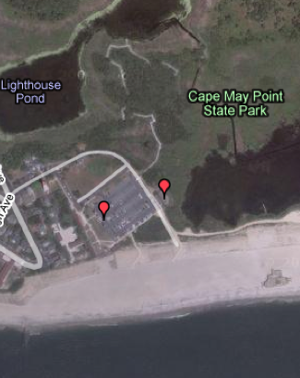
Location, location location!
eBird Rule of Thumb: refined locations are always better than broad-scale locations
Always be precise!
Use the ‘Find it on a map’ tool to plot your location
Use ‘Hotspots’ where appropriate
Use a GPS for lat/long
Avoid entering state and county level data for new observations
Merge big locations into smaller ones
Notes:
Exactly where you plot your birding locations on the map is critical for eBird in many ways. When you are specific with your location information we can perform better analyses, and we can ensure that your birding lists are built correctly. eBird thrives on location specificity, and a good general rule of thumb when entering data is that its always better to enter shorter checklists from more refined locations than longer checklists from a string of unrelated locations. More info here: http://ebird.org/content/ebird/news/location_specificity

Slide 24
What kind of birding did you do?
eBird Rule of Thumb: effort-based observations always trump casual observations
Understand the different types of birding
Describe your birding event
Use traveling, stationary or area counts
Traveling counts should be short (<5 mi)
Record time spent in the field
Note the number of observers
Notes:
What is an effort-based observation you ask? It’s simple, really. When you go birding you are probably conducting an effort-based observation and you don’t even realize it. Any time you take a walk, a hike, watch birds in your backyard or local park, essentially every time you are spending time watching birds with birding as your primary focus, you are conducting an effort-based observation. The key is to make sure and record the effort you expend watching birds, and then provide that information to eBird. For example, say you took a walk for an hour and you covered a distance of 2 miles. You’ve just completed an eBird Traveling Count, and your effort information would be a duration of one hour, and a distance of 2 miles. By simply providing this kind of information along with your checklist, you give scientists and analysts the ability to know so much more about your data. Imagine if you recorded 25 Caspian Terns on that walk. By telling us how far you went and how long you were birding we can get a better sense of how typical or atypical a count like this would be. If you provide no effort data, then these 25 terns could have been recorded on a single mud flat, or over the course of a 12 hour boat trip along the coast. The idea is to provide more information to the analyst describing your birding event. More info here: http://ebird.org/content/ebird/news/make-your-checklists-more-meaningful

Slide 25
Why estimate numbers?
eBird Rule of Thumb: estimating numbers is always better than putting an ‘X’ to indicate presence
An ‘X’ could be 1 or it could be 1,000,000 or more!
Numeric estimates allow study of relative abundance
Realize that estimates are just that – ‘estimates’
Be exact when possible, conservative always
Use ‘X’ for historic data where numeric estimates are lacking
Notes:
The problem with 'X’!
Simply put, when you record an 'X' on an eBird checklist it means that the bird was present in unknown numbers. In other words, an 'X' is at least 1, but could be 1,000,000 or more! The reality is that your best estimate of numbers will always convey more information about the birds than an 'X'.
Why record numbers?
All data submitted to eBird are valuable for certain types of basic analysis. But in order for your eBird submissions to be used for the highest level of scientific analysis, it is important that you begin to provide estimates of numbers for each species you encounter on your birding events. By doing this you add significant value to your submissions. A complete checklist with numbers for each species allows us to begin to study relative abundance, which in turn will allow us to analyze population trends in birds at a variety of spatial scales--from your backyard all the way up to the continental scale!
What if I'm not sure about my estimates?
Many birders do not record numbers because they are unsure of their ability to count birds accurately. At eBird all that we ask is that you make your best conservative estimate of the numbers of each species you've detected. You don't need to be exact. The fact is that every count made by birders is an estimate of some kind, and we rarely if ever make exact counts of all the possible birds present in a given birding situation. As such, analysts looking at numbers are keenly aware of the limitations of assuming these are exact counts, and adjust their models accordingly.
Estimating numbers in difficult situations
In order to help you feel more confident about providing numbers on your eBird checklists we've put together an article that describes general practices about how to count birds (Bird Counting 101: http://ebird.org/content/ebird/news/bird-counting-101), and one that provides guidance for counting birds in difficult situations (Bird Counting 201: http://ebird.org/content/ebird/news/bird-counting-201). We hope you enjoy these articles, and don't hesitate to contact us with questions about how to count birds.
Situations where 'X' is appropriate
When eBird was designed, the idea of allowing the inclusion of 'X' was meant to facilitate the entry of historic data where numbers for birds were lacking. If you have old checklists of birds from your past birding events that only have 'X's, we still want those, and using 'X' is appropriate in this case. Do not try to estimate numbers for past checklists, rather start from this point forward and submit complete checklists of birds with numbers for each species. By doing that you're adding tremendous value to your data, and to the eBird dataset as a whole.

Slide 26
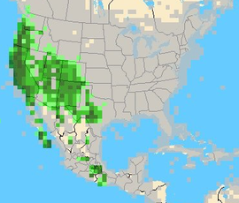
The value of the “complete” checklist
eBird Rule of Thumb: always report all the species you see or hear, not just the highlights of your day
Understand, and answer ‘yes’ to the “All species reported” question
Helps gather baseline data on all bird species
Makes birders more attentive
Allows us to map birds more accurately by showing presence (green) and absence (gray)
Notes:
On every eBird checklist birders are asked a simple question: "Are you submitting a complete checklist of the birds you saw/heard?" Though simple in concept, the power of reporting all species should not be underestimated. By submitting a complete checklist of the birds you saw or heard to the best of your ability, you are telling us not only about the birds you found, but you're also telling us that you did NOT observe a suite of other potential species. By submitting a complete checklist of birds we can learn more about where a species occurs with regularity, but equally important we can begin to say with certainty where it does not occur. This allows us to map entire species' ranges with more accuracy. When you submit a complete checklist of birds to eBird you're gathering data for only the species you observed, you are also gathering important "negative data" on a suite of other birds.
Some observers are confused by the meaning of the question: "Are you submitting a complete checklist of the birds you saw/heard?" What if you saw some birds that you couldn't identify? Do you then answer "no"? We want to find out whether you are reporting all the birds you were able to identify to the best of your ability. In other words, answer "Yes" to this question when you submit more than just the highlights of your birding event, and try to note every species present. We realize that all birds are not identifiable and user abilities vary. You should always answer "Yes" to this question unless you are purposefully excluding some species (e.g., European Starlings) from your checklist. You do not need to count all the individuals you observe to answer "Yes" to this question. A complete checklist indicates all species observed, and while estimates of numbers are valuable, they are not necessary to submit a complete checklist. We do, however, strongly recommend estimating numbers for each species on your list.
When eBird users submit complete checklists of birds it allows us to do a variety of interesting things. We can show where a species is found and where it hasn't been reported. We can calculate the chances that a species will be found at a given time of year in a certain locations. We can also begin to understand detectability, in other words, how easy or hard it is for birders to find a certain species. For instance, it's much easier to find singing Grasshopper Sparrows in spring than it is to find them when silent on the wintering grounds.
The Western Scrub-Jay map above shows the power of reporting all species. The gray shaded areas show where birders have submitted complete checklists, but have not detected Western Scrub-Jay. These are different from the tan areas, where we do not have enough complete checklists submitted determine whether Western Scrub-Jays are found there. From this map we can see that Western Scrub-Jays are found in the western United States and across much of Mexico. We can also see they are not found in the eastern United States. But we can't determine if they are found in much of northern Mexico, because we don't have enough complete checklists from this region.
Submitting complete checklists of birds allows eBird to realize its full potential and creates better lists for its users. Everyone likes highlights and the rare and unusual birds they see on their outings, but don't forget the common birds. By submitting data for all species you're collecting important information about all species, allowing us to make informed decisions about the next generation of rarities or species of special concern. Please report all species on every checklist you submit!

Slide 27
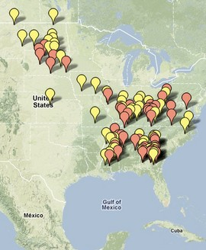
Bird off the beaten path
eBird Rule of Thumb: birding in under-birded regions provides important new information
eBird data density is tied to human population density
Seek out new birding locations
Conduct effort-based observations when
you get there
Notes:
Birders are not evenly distributed around the continent, and the same is certainly true for eBirders. There are some places, like Cook County, Illinois and Los Angeles, California, that benefit from having large populations. Birders have submitted over 21,476 checklists (341 species) for Cook County and over 19,000 checklists (489 species) for Los Angeles. But high populations alone don't always determine the number of checklists submitted. There are more checklists for Tompkins county, New York (24,285), than any other county--we suspect Cornell's location in the center of the county plays a critical role. And it's probably not too surprising that some exceptional birding locations like Cape May, NJ (14,197), rank high. Others benefit from a combination of factors: St. Louis, Minnesota, offers exceptional birding (home the Sax-Zim bog, Hawk Ridge, and Park Point); it's large (bigger than several eastern states) and benefits from the passionate participation of a small but dedicated number of eBirders. But there are other counties that are less well represented in eBird. We want your help to gather more information from those places. More information here: http://ebird.org/content/ebird/news/ebirds-most-wanted-counties

Slide 28
Data Quality
eBird Rule of Thumb: rare and unusual birds should be accompanied by written details and photos when possible
eBird rarities include: vagrants, aseasonal reports, and high counts
If eBird asks you to confirm your sighting, the species or count is unusual for the area
Please submit such records with care and use the comments field to provide a description, links to photos, etc.
Network of 500+ reviewers looks at each such record individually and may get in touch!
Notes:
Did you know that every record submitted to eBird goes through the eBird data verification process? Using a combination of automated data filters and a network of local experts, eBird tackles the issue of data quality in Citizen-Science. In order for us to maintain the integrity of the database, and for it to be used fully by the science and conservation community, we as observers must fully understand and strive to reach the highest level of data quality. Therefore, we've developed procedures to facilitate communication between eBird observers and scientists, including some new and improved review tools for our editors. Through our combined effort to maintain high data quality, eBird will take its place among the most valuable large-scale data sets on bird distribution and abundance in the world.
To facilitate the process of verifying records of rare and unusual birds, it’s helpful for the reviewers if you provide written details about the observation in the ‘notes’ section of the checklist page. Here you can also provide links to photos and other documentation you might have on the bird. Our regional editors might contact you by email for more information.
More info here: http://ebird.org/content/ebird/about/ebird-data-quality

Slide 29
Additional Resources
Want to learn more about contributing to eBird?
More about bird observation, identification & behavior?
Share photos, recordings:
  - FlickR, Picasa (Google), YouTube, SoundCloud.com
      Audio ID: AllAboutBirds.org, Xeno-canto.org
          Documenting Obs.: OOS Website
            BirdLog (smartphone app)
              “Birding Ohio” on Facebook
              www.ebird.org

Slide 30
Questions?

